Slide 1
Blockchain-based public uprightness check for distributed storage against hesitating inspectors
Domain : Blockchain
Batch no : A13
Guide
Mrs.C.Jackluin (Ass. Professor)
Team members
S.Harithaa ( 211417104081)
T .Anbarazsi ( 211417104015)
T.Lavanya (211417104131)

Slide 2
Introduction
In network computing era, network storage services achieve widespread adoption, security and performance issues are becoming primary concerns, affecting the scalability of storage systems.Most of the cloud users purchase cloud storage as "pay as you go" according to their data volume. In order to reduce the wastage of these cloud storage resources and to perform uprightness check for data, we propose blockchain-based deduplicatable data auditing mechanism. The cloud service provider(CSP) does not allow the owner to upload the duplicate files but later to the authentication of the owner, CSP can allow owner to make the updation of files that uploaded in cloud to avoid storage waste. To overcome the security issues, the data outsourcing and auditing processes also verified by the service provider and blockchain system is used to record those behaviors of both entities to monitor the unreliable third party auditors.

Slide 3
Literature Survey
s.no | Title | Author | Year | Inference | Drawbacks
1. | Security and privacy of big data in a cloud environment. Journal: International journal of network security and its apllication 8(1):59-79 | Sanjay Kumar Madria; | 2015 | In smart meters, data of the consumers must be protected else private information can be leaked. Similarly, due to the cost-efficiency, reduced overhead management and dynamic resource needs, content owners are outsourcing their data to the cloud who can act as a service provider on their behalf. However, by outsourcing their data to the cloud, the owners may lose access control and privacy of data as cloud becomes a third party. By using these data storage services, the data owners can relieve the burden of local data storage and maintenanc. | Since data owners and the cloud servers are not in the same trusted domain, the outsourced data may be at risk as the cloud server may no longer be fully trusted. Therefore, data integrity is of critical importance. Cloud should let the owners or a trusted third party to check for the integrity of their data storage without demanding a local copy of the data.
2. | Survey on secret sharing scheme with deduplication in cloud computing. Journal: 2015 IEEE 9th International Conference on Intelligent Systems and Control (ISCO) | Dharani P; Berlin M.A; | 2016 | Data deduplication is one of the techniques used for eliminating duplicate copies of data which is widely used in cloud to reduce storage space and increase bandwidth. Convergent encryption has been extensively adopted for secure deduplication, in order to use efficiently and reliably manage a huge number of convergent keys. A baseline approach named as Dekey is used to distribute the convergent key which would be shared across multiple servers. | A heavy computational cost is required to make n shares and recover the secret as a solution to this problem. Hence a new (k, L, n)-threshold ramp scheme is proposed which is perfect, idle and faster secret sharing scheme, every combination of k or more participants can recover the secret, but every group of less than k participants cannot obtain any information about the secret.

Slide 4
s.no | Title | Author | Year | Inference | Drawbacks
3. | DeyPoS: Deduplicatable Dynamic Proof of Storage for Multi-User Environments. Journal: IEEE Transactions on Computers ( Volume: 65, Issue: 12 Dec. 1 2016 | Kun He: Jing Chen; Ruiying Du; Qianhong Wu; | 2016 | Dynamic Proof of Storage (PoS) is a useful cryptographic primitive that enables a user to check the integrity of outsourced files and to efficiently update the files in a cloud server. we introduce the concept of deduplicatable dynamic proof of storage and propose an efficient construction called DeyPoS, to achieve dynamic PoS and secure cross-user deduplication. Considering the challenges of structure diversity and private tag generation, we exploit a novel tool called Homomorphic Authenticated Tree (HAT). | A practical multi-user cloud storage system needs the secure client-side cross-user deduplication technique, which allows a user to skip the uploading process and obtain the ownership of the files immediately, when other owners of the same files have uploaded them to the cloud server.
4. | Cooperative and Distributed Computation Offloading for Blockchain-Empowered Industrial Internet of Things. Journal: IEEE Internet of Things Journal ( Volume: 6, Issue: 5, Oct. 2019) | Wuhui Chen; Zhen Zhang; Zicong Hong | 2019 | A multihop cooperative and distributed computation offloading algorithm that considers the data processing tasks and the mining tasks together for blockchain-empowered IIoT. We study the multihop computation offloading problem for both the data processing tasks and the mining tasks to minimize the economic cost of IIoT devices. We formulate the offloading problem as a potential game in which the IIoT devices can make their decisions autonomously and prove the existence of Nash equilibrium (NE) for the game. We design an efficient distributed algorithm based on exchanging messages between IIoT devices to achieve the NE with low computational complexity. Our experimental results demonstrate that our distributed algorithm scales as well as the number of IIoT devices increases and has the minimum system cost compared with other approaches. | The computing capabilities in IIoT are usually limited, whereas the blockchain mining tasks are computationally intensive. Most of the existing solutions for offloading assume that all IIoT devices can directly connect to the ESs or cloud data centers.

Slide 5
s.no | Title | Author | Year | Inference | Drawbacks
5. | Attribute-based cloud data integrity auditing for secure outsourced storage, Journal: IEEE Transactions on Emerging Topics in Computing ( Volume: 8, Issue: 2, April-June 1 2020) | Y. Yu, Y. Li, B. Yang, W. Susilo, G. Yang, and J. Bai | 2017 | We seek to address the complex key management challenge in cloud data integrity checking by introducing attribute-based cloud data auditing, where users can upload files to cloud through some customized attribute set and specify some designated auditor set to check the integrity of the outsourced data. We formalize the system model and the security model for this new primitive, and describe a concrete construction of attribute-based cloud data integrity auditing protocol. The new protocol offers desirable properties namely attribute privacy-preserving and collusion-resistance. We prove soundness of our protocol based on the computational Diffie-Hellman assumption and the discrete logarithm assumption. Finally, we develop a prototype of the protocol which demonstrates the practicality of the protocol. | Data integrity, one of the most burning challenges in secure cloud storage. Outsourced data auditing protocols enable a verifier to efficiently check the integrity of the outsourced files without downloading the entire file from the cloud, which can dramatically reduce the communication overhead between the cloud server and the verifier. Existing protocols are mostly based on public key infrastructure or an exact identity, which lacks flexibility of key management.
6. | deduplication with encrypted data for cloud storage Journal: 2013 IEEE 5th International Conference on Cloud Computing Technology and Science | P. Puzio, R. Molva, M. Onen, and S. Loureiro, | 2013 | We propose , a secure and efficient storage service which assures block-level deduplication and data confidentiality at the same time. Although based on convergent encryption, ClouDedup remains secure thanks to the definition of a component that implements an additional encryption operation and an access control mechanism. Furthermore, as the requirement for deduplication at block-level raises an issue with respect to key management, we suggest to include a new component in order to implement the key management for each block together with the actual deduplication operation. | Any potentially untrusted cloud storage provider such as Amazon, Dropbox and Google Drive, can play the role of storage provider. As part of future work, ClouDedup may be extended with more security features such as proofs of retrievability , data integrity checking and search over encrypted data.

Slide 6
s.no | Title | Author | Year | Inference | Drawbacks
7. | Secure verifiable database supporting efficient dynamic operations in cloud computing Journal: IEEE Transactions on Emerging Topics in Computing ( Volume: 8, Issue: 2, April-June 1 2020) | J. Shen, D. Liu, M. Z. A. Bhuiyan, J. Shen, X. Sun, and A. Castiglione | 2017 | In this paper, we propose a secure verifiable database scheme that is based on the polynomial commitment for cloud computing, which can realize the verifiability of database records in the cloud. Moreover, the proposed scheme can support public verifiability in that all clients in the system can verify the database. In addition, we use the BLS signature and the index-hash table to construct dynamic operations for the database. Security analysis shows that our scheme can achieve real-world security requirements. The simulation results show that our scheme is more efficient than similar schemes. | The security analysis shows that our scheme can achieve the properties of security, correctness, verifiability and accountability. In the performance analysis, we compare our scheme with two similar schemes.The comparison results and simulation results indicate that our scheme is more efficient than similar schemes, which demonstrates that our scheme can be well used in secure verifiability for databases in cloud computing.
8. | Provable data possession at untrusted stores Journal: 2011 IEEE 17th International Conference on Parallel and Distributed Systems | G. Ateniese, R. Burns, R. Curtmola, J. Herring, L. Kissner, Z. Peterson, and D. Song, | 2007 | when the data is stored in the cloud storage device, a long time, enterprises and users inevitably will have security concerns, fearing that the information is actually stored in the cloud is still in the storage device or too long without access to, has long been the cloud server removed or destroyed, resulting in businesses and users in the future can’t access or restore the data files. Therefore, this scheme goal to research and design for data storage cloud computing environments that are proved. Stored in the cloud for data storage, research and develop a security and efficient storage of proof protocol, also can delegate or authorize others to public verifiability whether the data actually stored in the cloud storage devices. | We can provable data possession in the model, which reduce the data block access, but also reduce the amount of computation on the server and client and server traffic.. It exceeds what we did in the past, the improvement has brought to the bandwidth, computation and storage system. And it applied the public (third party) verification.

Slide 7
s.no | Title | Author | Year | Inference | Drawbacks
9. | Secure and constant cost public cloud storage auditing with deduplication Journal: 2013 IEEE Conference on Communications and Network Security (CNS) | J. Yuan and S. Yu | 2013 | In this paper we solve this open problem with a novel scheme based on techniques including polynomial-based authentication tags and homomorphic linear authenticators. Our design allows deduplication of both files and their corresponding authentication tags. Data integrity auditing and storage deduplication are achieved simultaneously. Our proposed scheme is also characterized by constant realtime communication and computational cost on the user side. Public auditing and batch auditing are both supported. Hence, our proposed scheme outperforms existing POR and PDP schemes while providing the additional functionality of deduplication. We prove the security of our proposed scheme based on the Computational Diffie-Hellman problem, the Static Diffie-Hellman problem and the t-Strong Diffie-Hellman problem. | we extend our design to support batch integrity auditing, and thus substantially save computational cost and communication cost for multiple requests scenarios. The security of our PCAD scheme is proved based on the CDH problem, the Static Diffie-Hellman problem and the tSDH problem. We validate the efficiency and scalability of our scheme through numerical analysis and experimental results on Amazon EC2 Cloud
10. | Secure and efficient proof of storage with deduplication Journal: IEEE Transactions on Information Forensics and Security ( Volume: 12, Issue: 3, March 2017) | Q. Zheng and S. Xu | 2012 | In this paper, we introduce a new primitive called µR-MLE2 which gives a partial positive answer for this challenging problem. We propose two schemes: static scheme and dynamic scheme, where the latter one allows tree adjustment by increasing some computation cost. Our main trick is to use the interactive protocol based on static or dynamic decision trees. The advantage gained from it is, by interacting with clients, the server will reduce the time complexity of deduplication equality test from linear time to efficient logarithmic time over the whole data items in the database. The security analysis and performance evaluation show that our schemes are Path-PRV-CDA2 secure and achieve several orders of magnitude higher performance for data equality test than R-MLE2 scheme when the number of data items are relatively large. | To achieve secure and efficient data deduplication, we construct two interactive schemes based on static and dynamic deduplication decision tree structures, respectively. The static deduplication decision tree is constructed based on the random elements from the client, which does not allow the tree to update. However, the dynamic deduplication decision tree is constructed based on the designed self-generation tree, which allows the server to conduct tree update and some other optiimization .

Slide 8
Problem Statement
The existing data auditing mechanism with deduplication cannot solve the problems such as high cost and reliance on trusted third parties in traditional approaches, and it also faces the problem of repeated auditing of data shared by multiple-tenant. We first design a client-side data deduplication scheme based on bilinear-pair techniques to reduce the burden on users and service providers. On this basis, we achieve a trustworthy and efficient data auditing mechanism that helps to check data integrity by using both the blockchain technique and bilinear pairing cryptosystem. The blockchain system is used to record the behaviors of entities in both data outsourcing and auditing processes so that the corresponding immutable records can be used to not only ensure the credibility of audit results but also help to monitor unreliable third-party auditors. Finally, theoretical analysis and experiments reveal the effectiveness and performance of our scheme.

Slide 9
Technology stack
SYSTEM REQUIREMENTS
HARDWARE REQUIREMENTS
PROCESSOR : INTEL CORE I9-9980XE
RAM : 4 GB DD RAM
MONITOR : 15” COLOR
HARD DISK : 250 GB
SOFTWARE REQUIREMENTS
FRONT END : J2EE (JSP, SERVLETS)
BACK END : MY SQL 5.5
OPERATING SYSTEM : WINDOWS 07
IDE : ECLIPSE

Slide 10
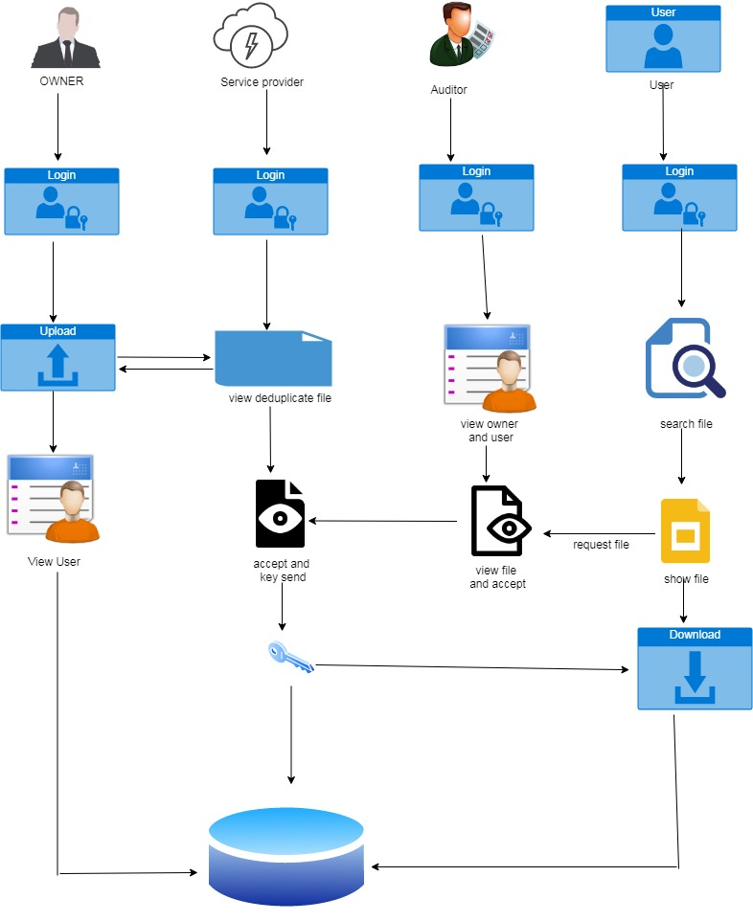
System Architecture

Slide 11
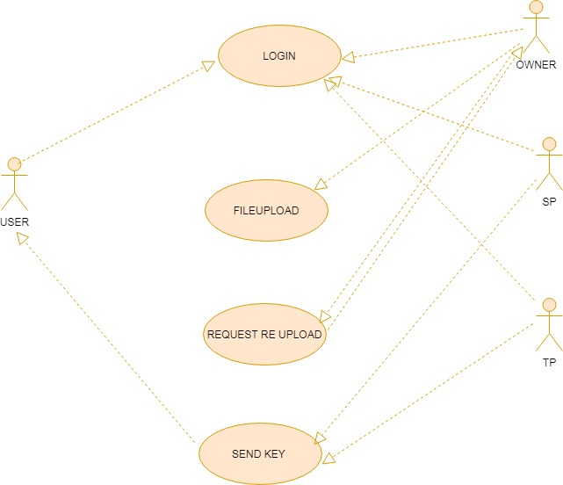
USE CASE DIAGRAM:

Slide 12
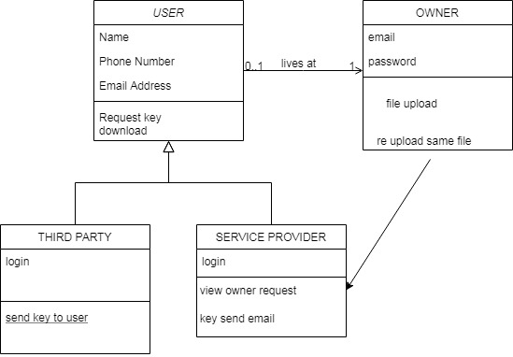
CLASS DIAGRAM:

Slide 13
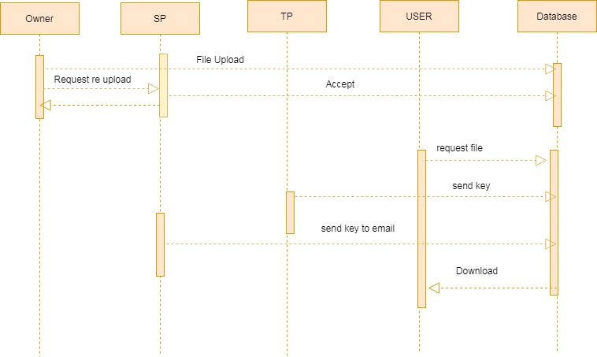
SEQUENCE DIAGRAM:

Slide 14
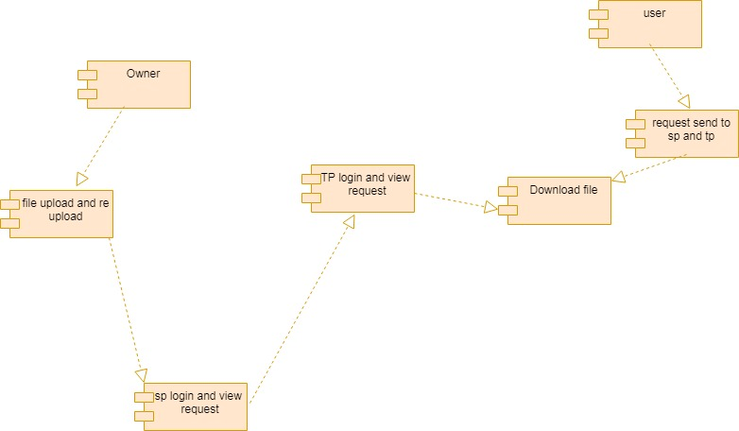
COMPONENT DIAGRAM:

Slide 15
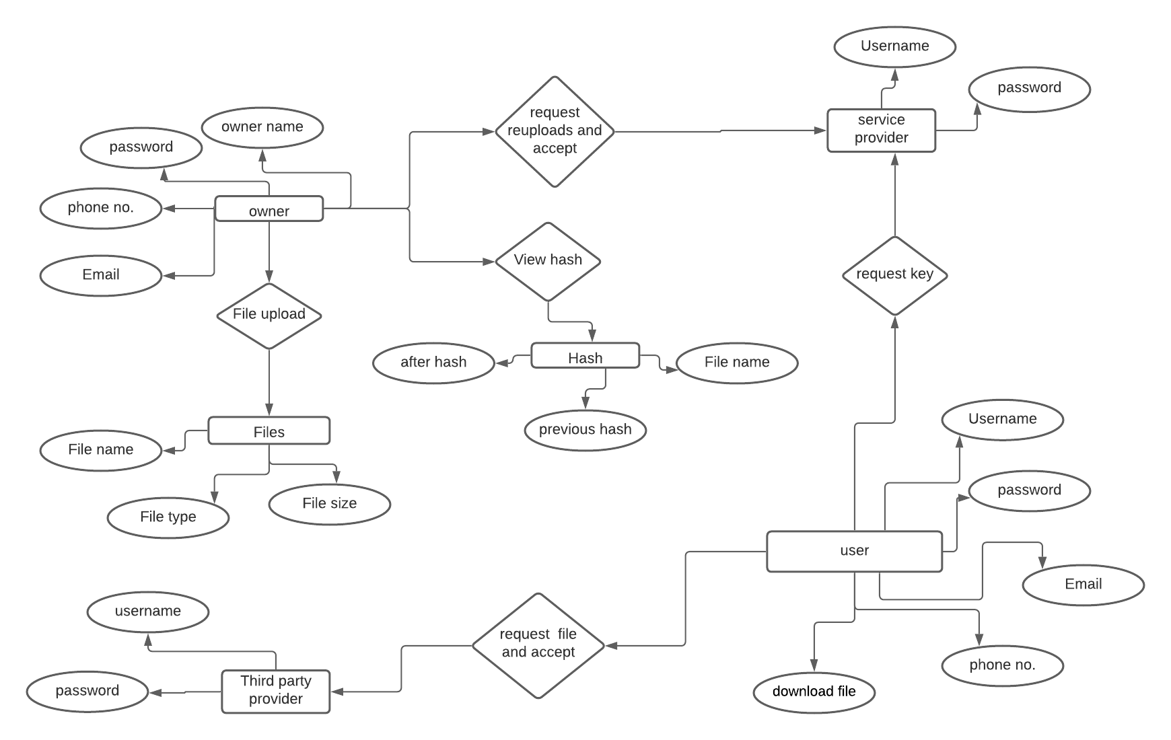
E-R DIAGRAM

Slide 16
MODULES:
USER INTERFACE DESIGN
FILE UPLOAD
SERVICE PROVIDER LOGIN ,REQUEST ACCEPT AND RE UPLOAD
USER REQUEST, RESPONSE FROM THIRD PARTY AND SERVICE PROVIDER SEND KEY

Slide 17
MODULE DESCRIPTION:
1. USER INTERFACE DESIGN
In this login page we have to enter login user id and password. It will check username and password is match or not (valid user id and valid password).
If we enter any invalid username or password, we can’t enter into login window to user window it will shows error message. So, we are preventing from unauthorized user entering into the login window to user window.
It will provide a good security for our project. So, server contain user id and password server also check the authentication of the user.
It well improves the security and preventing from unauthorized user enters into the network.
2. FILE UPLOAD
In this module, after login the owner will upload using Blockchain(hash functions) the file details and it will be stored in the database.

Slide 18
3. SERVICE PROVIDER LOGIN ,REQUEST ACCEPT AND RE UPLOAD
In this module, given details to login and view what are all the files uploaded by owner.
In this module, Owner request a file to service provider which file want to re uploading give accept and owner reuploading a same file name and stored a database.
4.USER REQUEST, RESPONSE FROM THIRD PARTY AND SERVICE PROVIDER SEND KEY
In this module, the user will be sending the file request to the third party for which files, the user needs the access. Without the permission form the third party and service provider, the user can’t able to download the file.
In this module, the Third party send key and service provider send key through user mail will be giving the acceptance to the user for which file needs the access. After the acceptance, the file key will be send to the user.
In this module, after getting the key from the third party and service provider, the user can download the file using the key provided by the service provider.

Slide 19
Testing and Performance Evaluation
S.NO | ACTION | INPUT | EXPECTED OUTPUT | ACTUAL OUTPUT | TEST RESULT
1. | Enter valid name, email, phno, password, confirm password | Name: xxx Email: xxx@gmail.com Phno:9423539453 Password:*** Confirm password:*** | xxx xxx@gmail.com 9423539453 *** *** | xxx xxx@gmail.com 9423539453 *** *** | PASSED
2. | Enter valid email and password | Email: xxx@gmail.com Password: *** | xxx@gmail.com *** | xxx@gmail.com *** | PASSED
3. | Compare email and password with registered field | Email: xxx@gmail.com Password: *** | Owner Page | Owner Page | PASSED
S.NO | ACTION | INPUT | EXPECTED OUTPUT | ACTUAL OUTPUT | TEST RESULT
1. | Enter valid username and password | Username: Service Password: *** | Service *** | Service *** | PASSED
2. | Compare username and password with registered field | Username: Service Password: *** | Service Provider Page | Service Provider Page | PASSED

Slide 20
S.NO | ACTION | INPUT | EXPECTED OUTPUT | ACTUAL OUTPUT | TEST RESULT
1. | Enter valid username, email, password, confirm password and phno | Username: xxx Email: xxx@gmail.com Password: *** Confirm password:*** Phno:9453623491 | xxx xxx@gmail.com *** *** 9453623491 | xxx xxx@gmail.com *** *** 9453623491 | PASSED
2. | Enter valid email and password | Email: xxx@gmail.com Password: *** | xxx@gmail.com *** | xxx@gmail.com *** | PASSED
3. | Compare email and password with registered field | Email: xxx@gmail.com Password: *** | User Page | User Page | PASSED
S.NO | ACTION | INPUT | EXPECTED OUTPUT | ACTUAL OUTPUT | TEST RESULT
1. | Enter valid username and password | Username: Admin Password:*** | Admin *** | Admin *** | PASSED
2. | Compare username and password with registered field | Username: Admin Password:*** | Third Party Page | Third Party Page | PASSED

Slide 21
S.NO | ACTION | INPUT | EXPECTED OUTPUT | ACTUAL OUTPUT | TEST RESULT
1. | To upload a file in owner page | Choose file: xxx.pdf | File uploaded successfully | File uploaded successfully | PASSED
2. | To request a file in user page | Request the file which uploaded | Request sent successfully | Request sent successfully | PASSED
3. | To accept the user request in third party page | Accept the user request | Request accepted successfully | Request accepted successfully | PASSED
4. | To send key to the user in third party page | Send the key to user | Key sent successfully | Key sent successfully | PASSED
5. | To download the file in user page | Filekey: xxx Cspkey: xxx | File downloaded | File downloaded | PASSED

Slide 22
S.NO | ACTION | INPUT | EXPECTED OUTPUT | ACTUAL OUTPUT | TEST RESULT
1. | To request a file in owner page | Request the file which uploaded. Message: xxx | Request sent successfully | Request sent successfully | PASSED
2. | To accept the owner request in service provider page | Accept the owner request | Request accepted successfully | Request accepted successfully | PASSED
3. | To upload a new file in owner page | Choose file: yyy.pdf | New file uploaded successfully | New file uploaded successfully | PASSED
4. | To download a new file in user page | Filekey: xxx Cspkey: xxx | File downloaded | File downloaded | PASSED

Slide 23
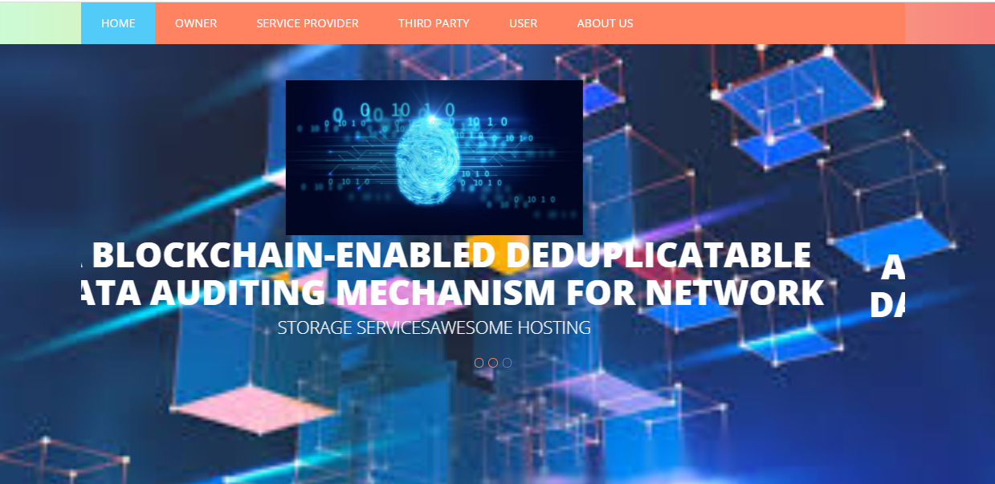
Screenshots

Slide 24
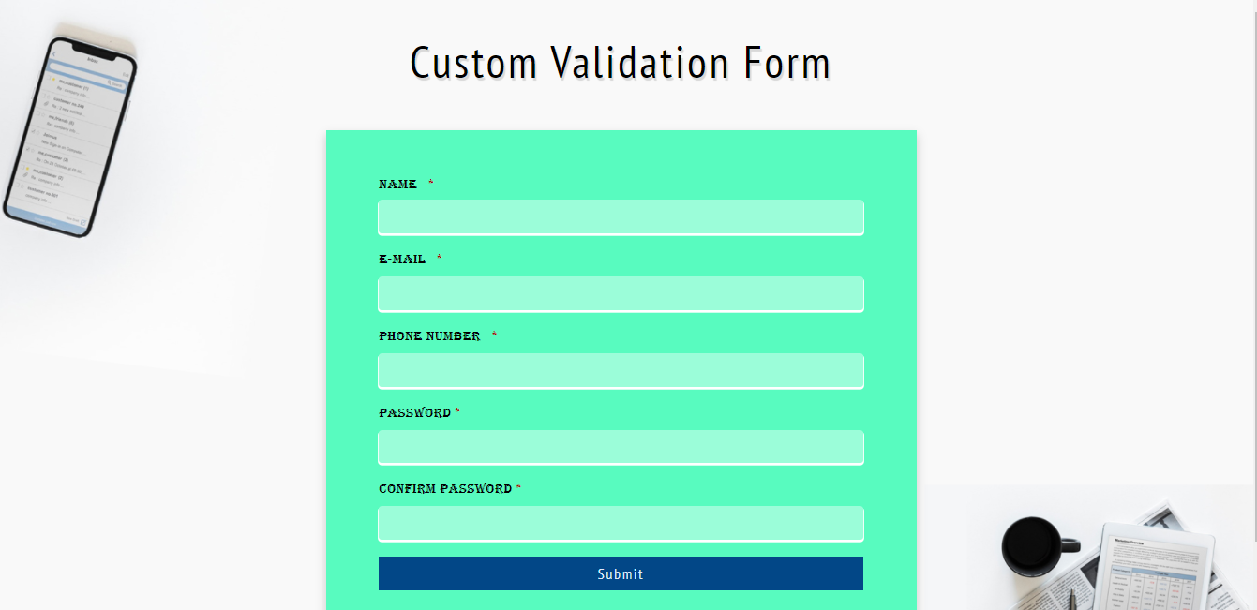

Slide 25
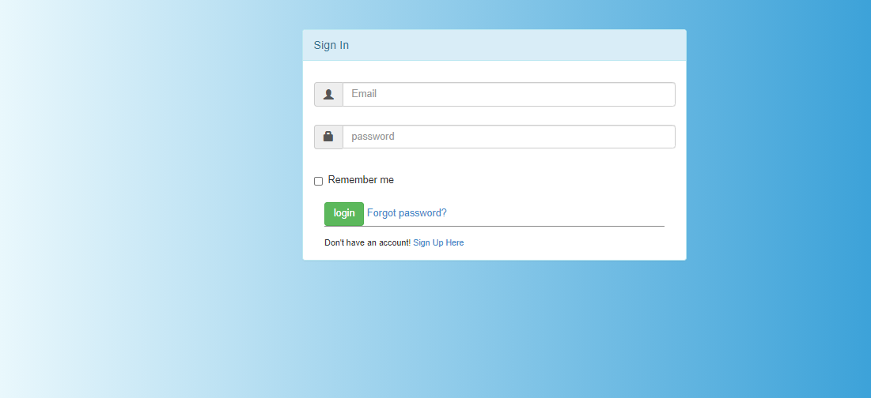
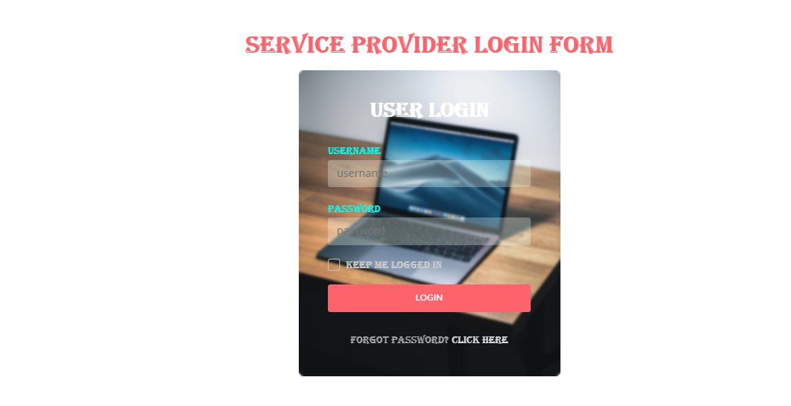

Slide 26


Slide 27
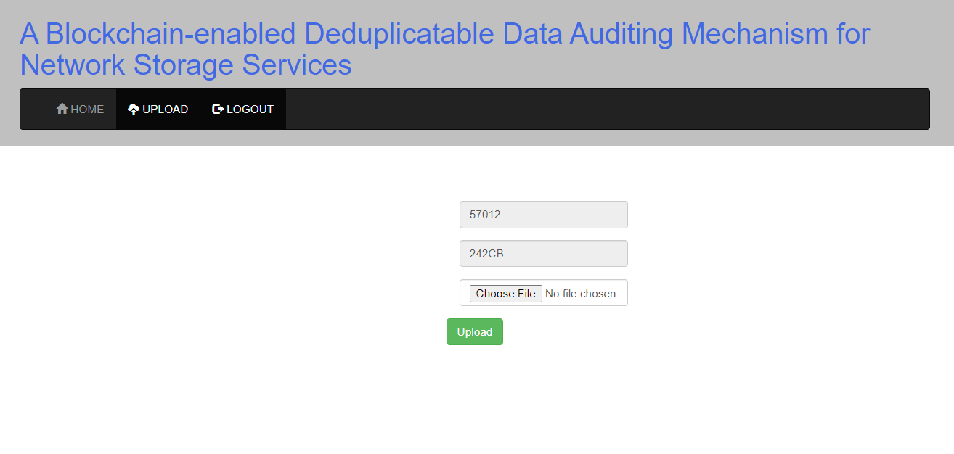

Slide 28
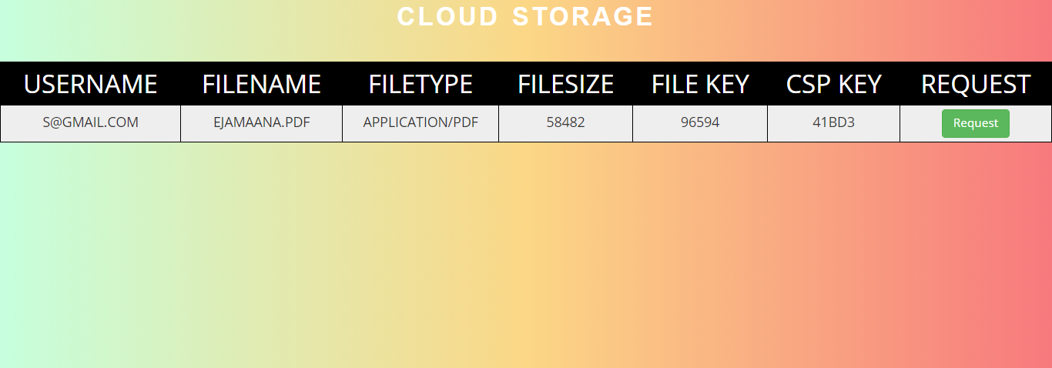
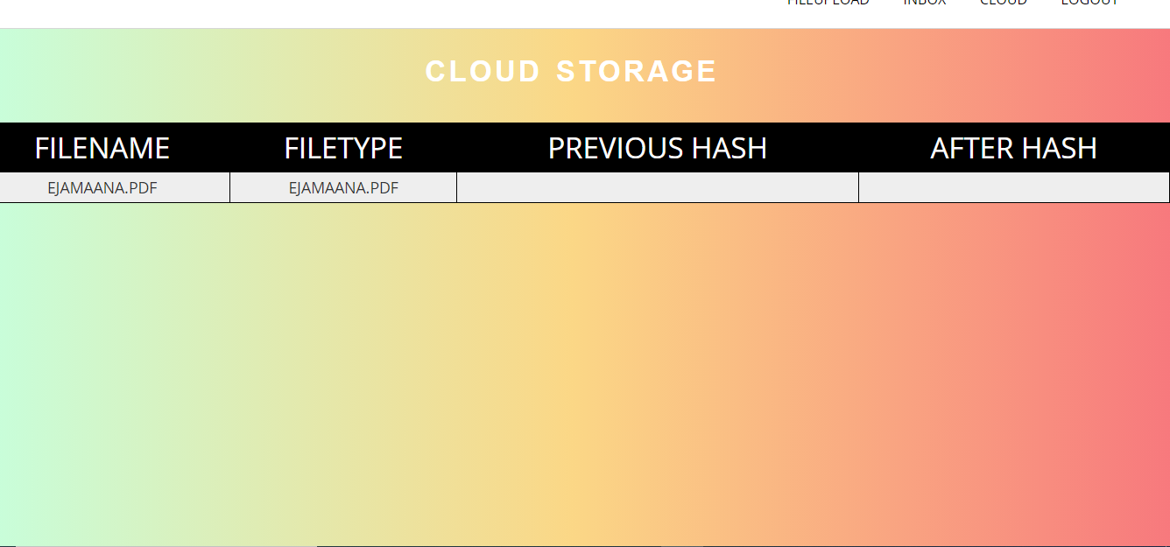

Slide 29
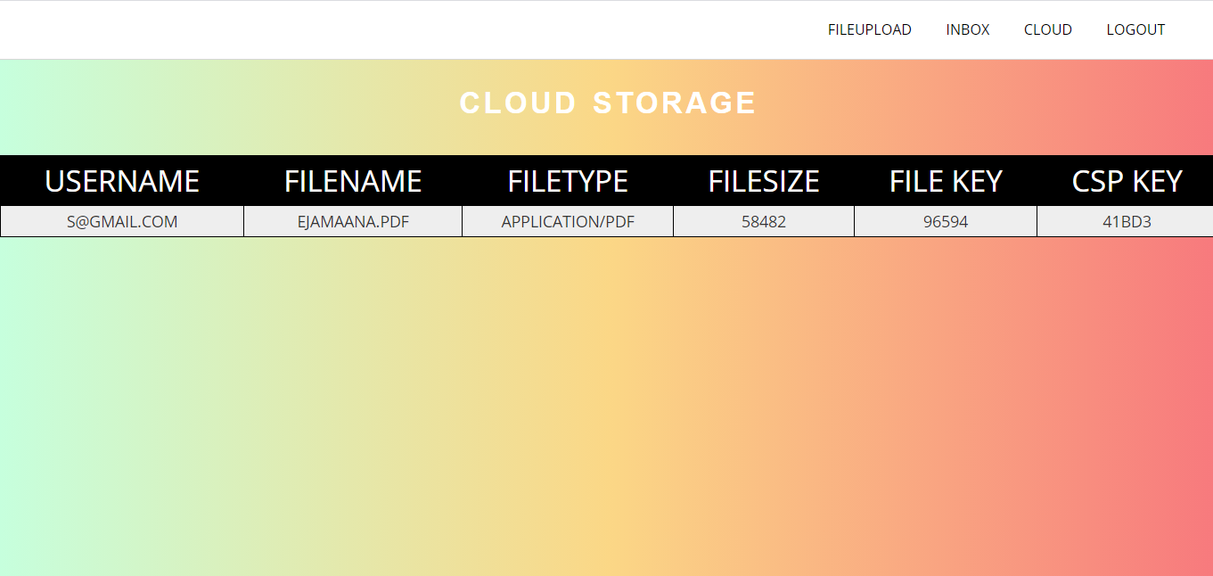
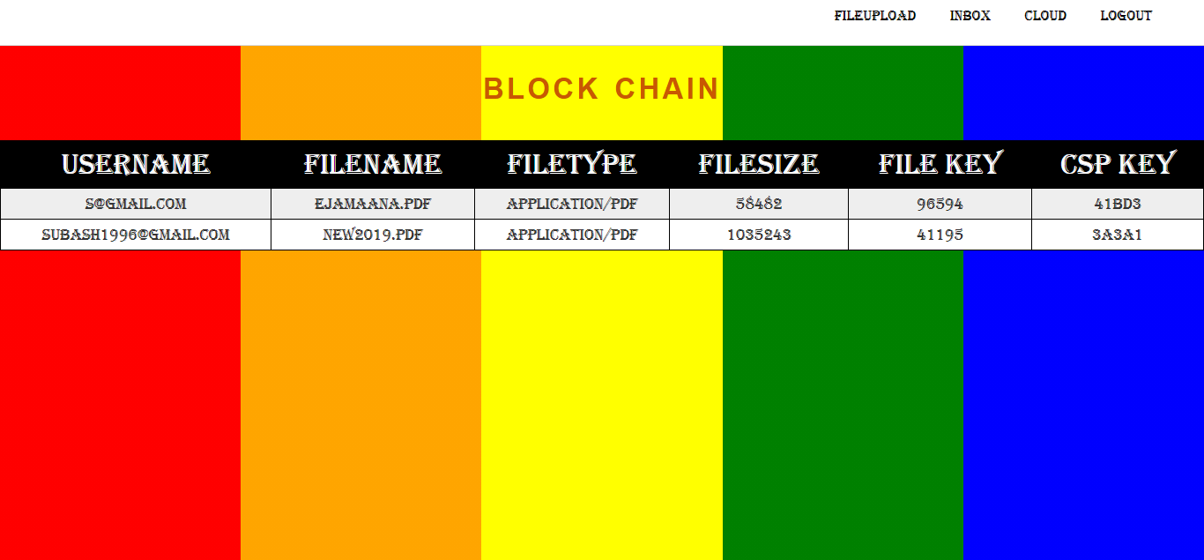

Slide 30
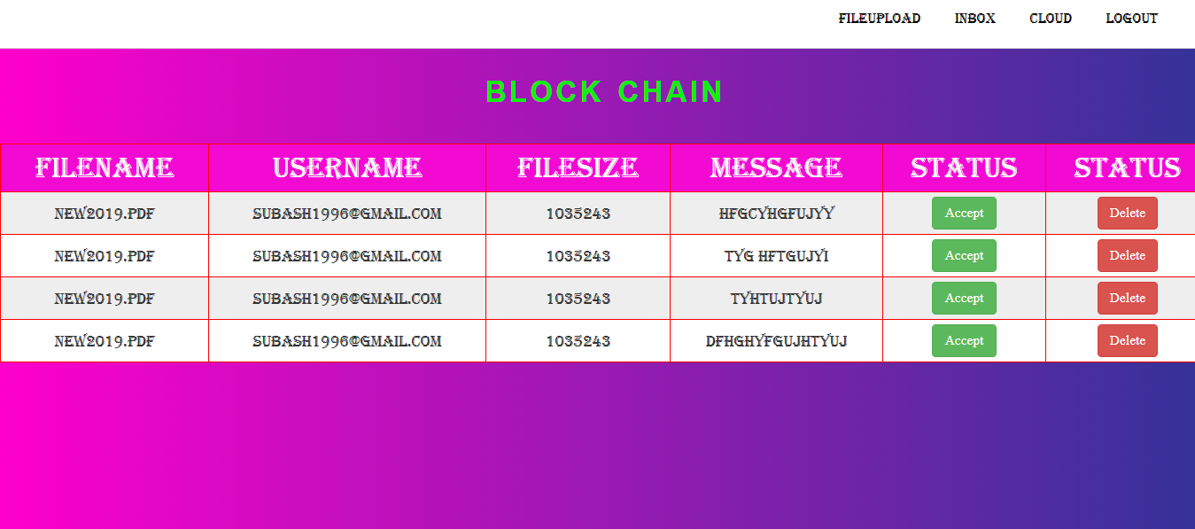
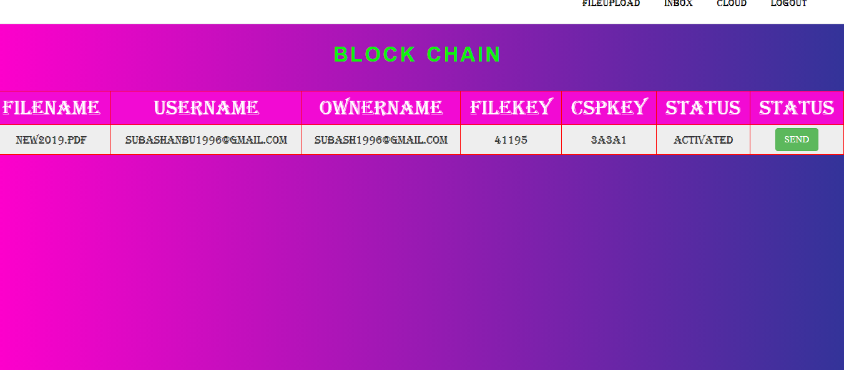

Slide 31
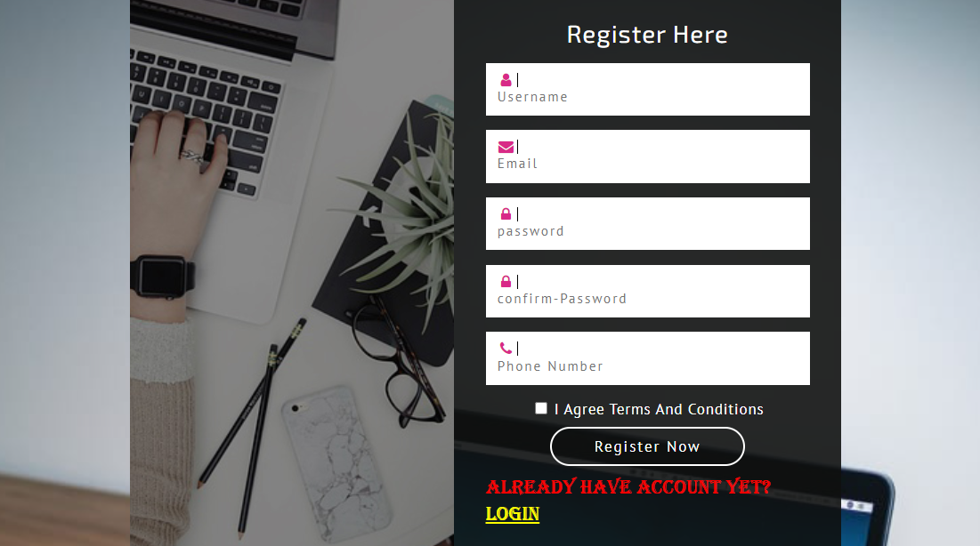

Slide 32
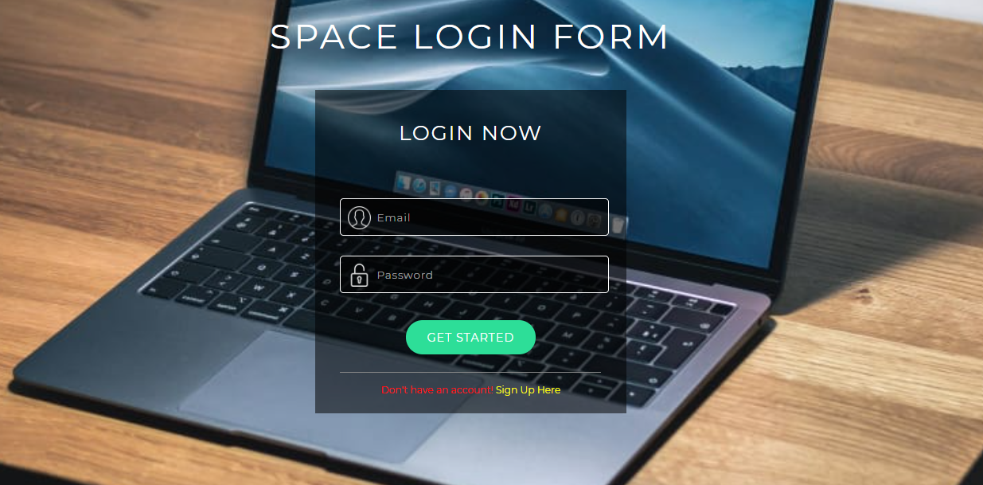

Slide 33
CONCLUSION:
This paper proposes a blockchain-enabled deduplicatable data auditing mechanism to improve the efficiency of the network storage service and protect the users’ data. With the assistance of the deduplication technology, the network storage service provider can remove the duplicate data that the user outsourced and save only one copy, thereby reducing the storage burden. On this basis, we designed a blockchain-based data audit mechanism to ensure the integrity of outsourced data and avoid repeated audits by multiple tenants. The blockchain technique is introduced to record the data auditing log, thereby monitoring untrusted TPA during the data auditing process.

Slide 34
REFERENCES:
[1] D. Reinsel, J. Gantz, and J. Rydning, “Data age 2025: The digitization of the world: from edge to core,” Int. Data Corporation(IDC), pp. 1–28, 2018.
[2] F. Zafar, A. Khan, S. U. R. Malik, M. Ahmed, A. Anjum, M. I. Khan, N. Javed, M. Alam, and F. Jamil, “A survey of cloud computing data integrity schemes: Design challenges, taxonomy and future trends,” Computers & Security, vol. 65, pp. 29–49, 2017.
[3] L. Zhou, A. Fu, S. Yu, M. Su, and B. Kuang, “Data integrity verification of the outsourced big data in the cloud environment: A survey,” J. Netw. Comput. Appl., vol. 122, pp. 1–15, 2018.
[4] J. Gratz and D. Reinsel, “The digital universe decade-are you ready?” IDC White Paper, pp. 1–16, 2010.
[5] Y. Shin, D. Koo, and J. Hur, “A survey of secure data deduplication schemes for cloud storage systems,” ACM Comput. Surveys (CSUR), vol. 49, no. 4, pp. 74–112, 2017.

Slide 35
[6] G. Ateniese, R. Burns, R. Curtmola, J. Herring, L. Kissner, Z. Peterson, and D. Song, “Provable data possession at untrusted stores,” in Proc. 14th ACM Conf. Comput. Commun. Security, 2007, pp. 598–609.
[7] H. Shacham and B. Waters, “Compact proofs of retrievability,” in Proc. Int. Conf. Theory Appl. Cryptol. Inf. Security, 2008, pp. 90–107.
[8] Y. Zhu, H. Hu, G.-J. Ahn, and M. Yu, “Cooperative provable data possession for integrity verification in multicloud storage,” IEEE Trans. Parallel Distrib. Syst., vol. 23, no. 12, pp. 2231–2244, 2012.
[9] Y. Yu, Y. Li, B. Yang, W. Susilo, G. Yang, and J. Bai, “Attribute-based cloud data integrity auditing for secure outsourced storage,” IEEE Trans. Emerg. Topics Comput., vol. 14, no. 8, pp. 1–13, 2017.
[10] J. Shen, D. Liu, M. Z. A. Bhuiyan, J. Shen, X. Sun, and A. Castiglione, “Secure verifiable database supporting efficient dynamic operations in cloud computing,” IEEE Trans. Emerg. Topics Comput., pp. 1–11, 2017, doi: 10.1109/TETC.2017.2776402.

Slide 36
[11] S. Halevi, D. Harnik, B. Pinkas, and A. Shulman-Peleg, “Proofs of ownership in remote storage systems,” in Proc. 18th ACM Conf. Comput. Commun. Security, 2011, pp. 491–500.
[12] P. Puzio, R. Molva, M. Onen, and S. Loureiro, “Cloudedup: Secure ¨ deduplication with encrypted data for cloud storage,” in Proc. 5th Int. Conf. Cloud Comput. Technol. Sci., vol. 1, 2013, pp. 363–370.
[13] S. Li, C. Xu, and Y. Zhang, “CSED: Client-side encrypted deduplication scheme based on proofs of ownership for cloud storage,” J. Inf. Security Appl., vol. 46, pp. 250–258, 2019.
[14] Q. Zheng and S. Xu, “Secure and efficient proof of storage with deduplication,” in Proc. 2nd ACM Conf. Data Appl. Security Privacy, 2012, pp. 1–12.
[15] J. Yuan and S. Yu, “Secure and constant cost public cloud storage auditing with deduplication,” in Proc. IEEE Conf. Commun. Netw. Security (CNS), 2013, pp. 145–153.

